Slide 1
Balanced Binary Tree
Fernando Donis – 20210415

Slide 2
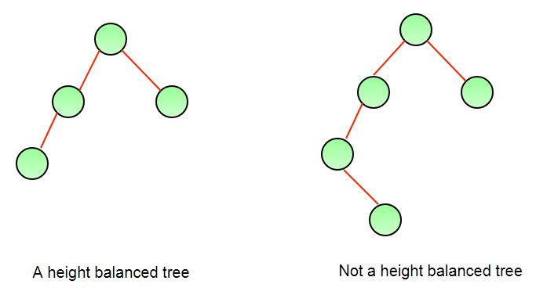

Slide 3
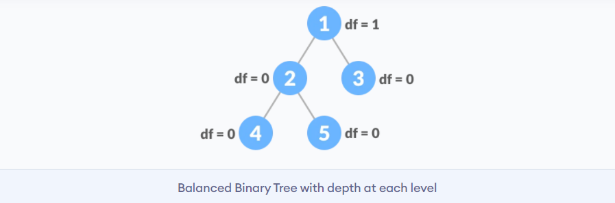
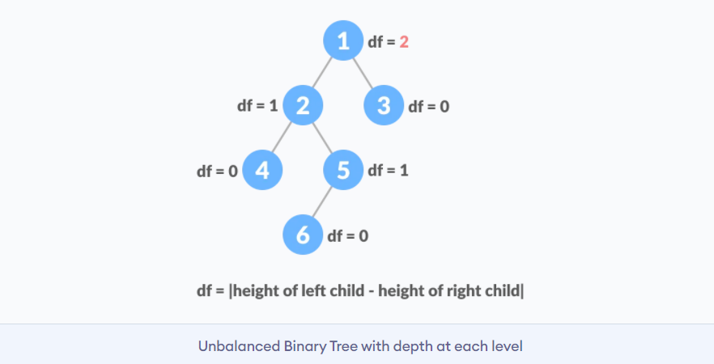

Slide 4
The difference between the left and the right subtree for any node is not more than one

Slide 5
Disadvantages:
Shape of the tree depends upon order of insertion and it can be degenerated.
Searching takes long time.
Advantages:
fast in insertion and deletion when balanced.
Very efficient and its code is easier than link lists.

